Slide 1
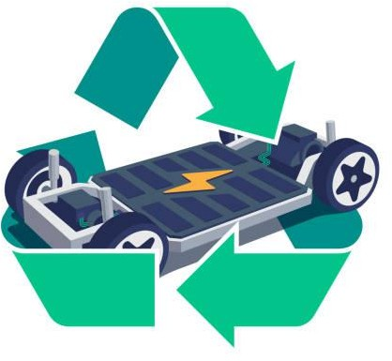

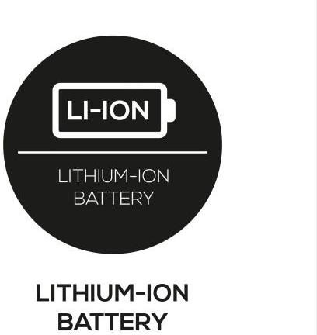

Course Name : Sustainability Engineering
Course Code : ENGG 682
Term : Fall 2024
Life Cycle Assessment of LFP and NMC battery Production in Nevada, USA
Group No : 12
Team Members:
Atik Iqbal Patel ( UCID : 30253116)
Abdullah Ibn Masud (UCID : 30250029 )
Mohammad Saed Sidibe (UCID: 30246025)
Tanbir Rahman (UCID : 30239940)
Ariful Islam Anik (UCID :302145251)

Slide 2
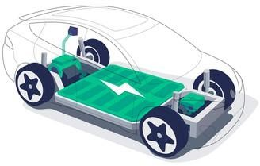

Introduction
The greatest threat to our planet is the belief that someone else will save it."
— Robert Swan
Green Transition : Fossil fuels to Sustainable energy
Need for efficient energy storage for EVs and other electronic devices
Invention of Li-Ion batteries
Current Method : Lithium Iron Phosphate batteries (LFP)
Alternative Method : Nickel Manganese Cobalt Lithium Ion batteries (NMC)
Geographical Locations
LFP Batteries : Gigafactory, Storey county, Nevada, USA
NMC Batteries : Dragonfly Energy, Reno, Nevada, USA
Scope and Boundary : Cradle to Gate

Slide 3



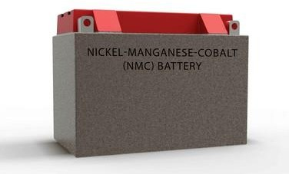
Background of the problem
LFP batteries advantages:
→ Better durability, thermal stability and longer life cycle
→Lower Production cost
LFP batteries challenges:
→ Lower Energy Density, limited cold weather performance
→Bulkier design
→ Higher carbon footprint on the environment
NMC as an Alternative:
→ High energy density, effective performance over wide range of temperatures
→Better profitability
→ Compact design and easy transportation

Slide 4


Approach to Measure sustainability
Sustainability Metrics : Environment, Economic and Social
Category | Environment Sustainability | Social Sustainability | Economic Sustainability
Indicator Analysed | Abiotic Depletion Potential Global warming Potential Acidification Potential | Health and safety Demography Inequality Cultural tensions Employment Education Economic Development | Efficiency Gross Profit
Sustainability score calculation

Slide 5




Stakeholder Consideration
Local communities surrounding mining projects
Manufacturing Industry
Government and National regulatory agencies
NGOs
Employees/Workers
Automobile companies (retailers)
Consumers of electric vehicle and other electronic
products
Waste management companies
Investors
Researchers and academic institutions
Issues addressed : Environmental. Economical and Social and benefits after considering the
alternative

Slide 6

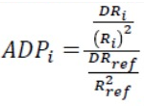

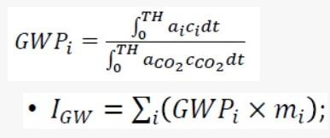




Environmental Indices Calculations
Impact | Formula Used | LFP | NMC | Direction
Abiotic Depletion Potential (ADP) |  | 15.691 kg Sb eq | 9.427 kg Sb eq | – +
Global Warming Potential (GWP) |  | 348.710 kg CO₂ eq | 229.45 kg CO₂ eq | – +
Acidification Potentials (ARP) |  | 3.254 SO₂ eq | 1.653 SO₂ eq | – +

Slide 7

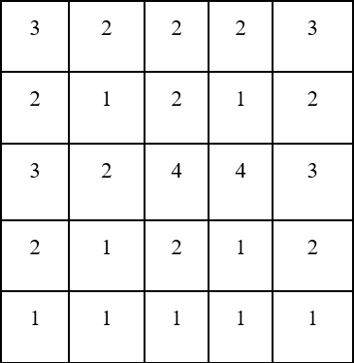
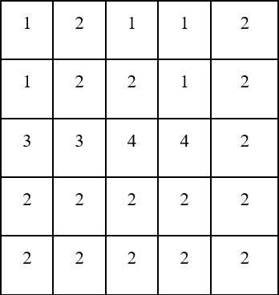
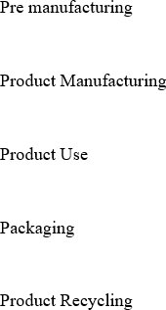




Performance score for LFP and NMC
MS: Material Selection, EU: Energy usage, SR : Solid residue, LR: Liquid Residue, GR: Gaseous residue
LFP NMC

Slide 8


Economic Analysis of LFP and NMC Processes
The economic study of manufacture of LFP batteries and NMC batteries in Nevada, highlights significant variations in costs and resource availability.
Raw Materials Cost:
LFP NMC
Raw Material | Mass (kg) | Unit Price (USD/kg) | Total Cost (USD)
Lithium Carbonate | 234.18 | 26.23 | $6142.54
Iron | 354.02 | 12.21 | $4332.34
Conductive Carbon | 57.10 | 1.98 | $113.06
Phosphoric Acid | 621.13 | 2.61 | $1621.15
Total | 1,266.43 |  | $12,209.29
Raw Material | Mass (kg) | Unit Price (USD/kg) | Total Cost (USD)
Nickel (II) Sulfate | 538.0 | 3.63 | 1,952.94
Manganese (II) Sulfate | 524.96 | 1.3 | 682.45
Cobalt (II) Sulfate | 538.87 | 8.77 | 4,725.88
Sodium Hydroxide | 834.38 | 0.51 | 417.19
Lithium Carbonate | 385.33 | 26.23 | 10107.21
Total | 2821.54 Kg |  | $ 17,885.46

Slide 9


Energy Cost
For LFP
Energy needed for 1000 kg = 1000 kg×65KWh/kg=65000 KWh
Energy Cost = 65000 kWh×0.06 $/kWh=$3900
For NMC
Energy needed for 1000 kg: 1000kg×100kWh/kg =10000kWh
Energy Cost = 10000kWh×0.06$/kWh =$6000
NV Electricity Rates | Electricity Local

Slide 10


Economic Analysis of LFP and NMC Processes
Type of cost | LFP (Amount in $/1000kg) | NMC (Amount in $/1000kg)
Cost of Raw Materials | 12209.29 | 17885.46
Cost of Energy | 3900 | 6000
Manufacturing Cost(Raw+Energy+Misc.) | 16,123.35 | 23889.28
Selling Price | 34,769.06 | 79,477.60
Gross Profit | 18,645.71 | 55,588.32
Efficiency | 2.16 | 3.33

Slide 11
Social Indicators
We have analysed multiple social sustainability indicators for LFP and NMC method
Health and Safety
Chemical Exposure:
LFP: Phosphates are highly reactive and causes formation of phosphoric acid, which is a corrosive byproduct (-)
NMC: The intermediates of NMC processing are more chemically stable during production (+).
LFP: Thermally stable at higher temperature (+)
NMC: Thermally unstable at higher temperature (-)
Dust Exposure:
LFP: Fine particles LFP cathode powder disperse easily and cause respiratory risks. (-)
NMC: Greater particle size/slurry form during process reduces airborne exposure risks (+)
Demography
Displacement:
LFP: Rising costs of houses near Gigafactory caused displacement of lesser privileged people (-)
NMC: Influx of people resulted in initial inflation in housing but lesser affordability brought the housing priced down (+)
Inequality
Economic Disparity:
LFP and NMC: Depriving the middle-skilled ones; better economic opportunities only for the highly skilled and low-wage workers (-)
Cultural Tensions
Indigenous Communities:
LFP: Issues related to destruction of native land (Native Americans) (-)
NMC: Local culture at risk due to difficulty of newcomers to assimilate and Reno-Sparks Indian Colony faces urbanization and economic (-)

Slide 12
Employment
Job Creation:
LFP: Gigafactory local employment reduced from 7.5% to 3.4% from 2010 to 2013 (+).
NMC: NMC companies created 2,300+ jobs and increased the average wage to $32.67 (+).
Education
Skill Development:
LFP: Training program of 1,000+ skilled workers by Truckee Community College under Gigafactory (+)
NMC: Collaboration of Dragonfly Energy with University of Nevada and entrepreneurs (+).
Economic Development
Community and Infrastructure Investment:
LFP: Gigafactory contributes to local infrastructure such as education, healthcare and transportation (+).
NMC: Dragonfly Energy contributes to national projects and assists in local businesses (+).

Slide 13
Conclusion
1) Environmental Impact: Compared to the LFP method, which produces fine particulate matter that causes respiratory problems and more environmental damage, the NMC battery production process emits fewer pollutants.
2) Economic Metrics: NMC batteries have stronger long-term economic viability than LFP batteries due to their
substantially larger gross revenues, despite higher initial cost and production cost.
3) Social Impact: Both LFP and NMC producing companies contributed significantly to job creation in the Nevada region. However, indigenous tribes have been displaced by mining for both processes.
4) Stakeholder Interests: Economic and environmental concerns are given top priority by stakeholders, and NMC
performs better than LFP in terms of adhering to more stringent government environmental laws.
5) Research and Development: In order to promote sustainable battery production and encourage innovation, NMC manufacturers make significant investments in R&D, work with academic institutions, and assist startups.
6) Technological Advantage: NMC batteries are a more viable option for electric vehicles because of its higher
energy density, compact & smaller size, and improved performance in colder climates.
7) Final Verdict: When stakeholder interests and environmental, economic, and social factors are taken into account,
NMC batteries stand out as a better, more sustainable option than LFP batteries.

Slide 14
References
[1] | J. S. Antti Väyrynen, “Lithium ion battery production,” J. Chem. Thermodynamics, 2012.
[2] | Tesla, “Gigafactory Nevada,” 2024. [Online]. Available: https://www.tesla.com/en_ca/giga-nevada.
[3] | WikiMili, “Giga Nevada,” 14 July 2024. [Online]. Available: https://wikimili.com/en/Giga_Nevada.
[4] | R. D. News, “Panasonic to build $4B EV battery plant in Kansas,” 2022.
[5] | J. S. Antti Väyrynen, “Lithium ion battery production,” J. Chem. Thermodynamics, 2012.
[6] | TROES, “LFP vs NMC: Best Battery for Energy Storage,” 2024. [Online]. Available: https://troescorp.com/lfp-vs-nmc-best-battery-for-energy-storage/.
[7] | S. Evro, “Navigating battery choices: A comparative study of lithium iron phosphate,” Future Batteries, 2024.
[8] | H. Bo, “Preparation method of lithium iron phosphate,” Google Patents, 2010.
[9] | C. Xu, “Overview of Preparation Process of Lithium Iron Phosphate Batteries for New Energy Vehicles,” Highlights in Science Engineering and Technology, 2024.
[10] | K. Fröhlich, “New large-scale production route for synthesis of lithium,” J Solid State Electrochem, May 2017.
[11] | M. Habowska, Water based Lithium-Nickel-Manganese-Cobalt-Oxide-Slurry preparation as Cathodes for Li-Ion Batteries, Vienna: Bibliothek, 2020.
[12] | N. Omar, “Lithium iron phosphate based battery – Assessment of the aging parameters and development of cycle life model,” Applied Energy, 2013.
[13] | GREPOW, “Disadvantages of LFP Battery,” December 2023. [Online]. Available: https://www.grepow.com/lfp-battery-encyclopedia/what-are-the-advantages-and-disadvantages-of-lfp- battery.html.
[14] | N. R. Association, “Displacement and Gentrification,” 2023.

